Slide 1

Rising Copper, Rising Stakes
LTC by Nexans & Aurubis
November 25th, 2025 at 4:00 PM

Slide 2
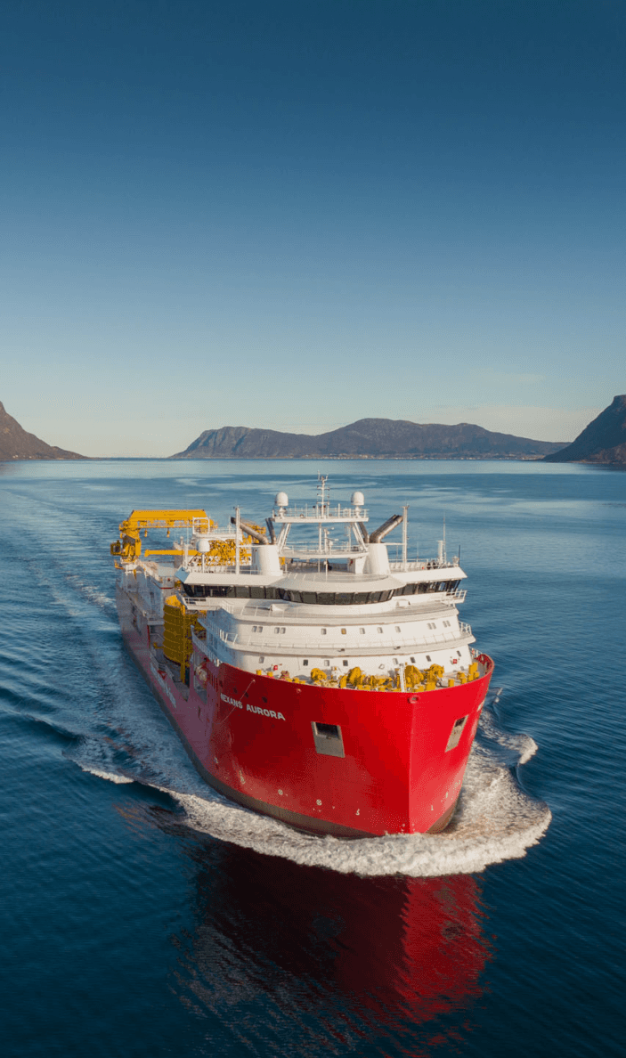

Key Figures
€7.1^{BN}
  ADJUSTED EBITDA​
  HEADQUARTERS
2024 KEY FINANCIAL INDICATORS OF THE GROUP
€804^{M}
Paris, FR
  STANDARD SALES⁽¹⁾
Nexans is listed on Euronext Paris compartment A.​
28,500
  ROCE
  of
  NORMALIZED FREECASH FLOW⁽²⁾
  EMPLOYEES
21.1%
€454^{M}
  INDUSTRIAL IMPLANTATIONS IN
  A Global
A
41 countries
  COMMERCIAL
  PRESENCE
        Revenue at standard metal price
        Free Cash-Flow excluding Strategic Capex, disposal proceeds of tangible assets, impact of material activity closures and assuming project tax cash-out based on completion rate rather than termination.

Slide 3
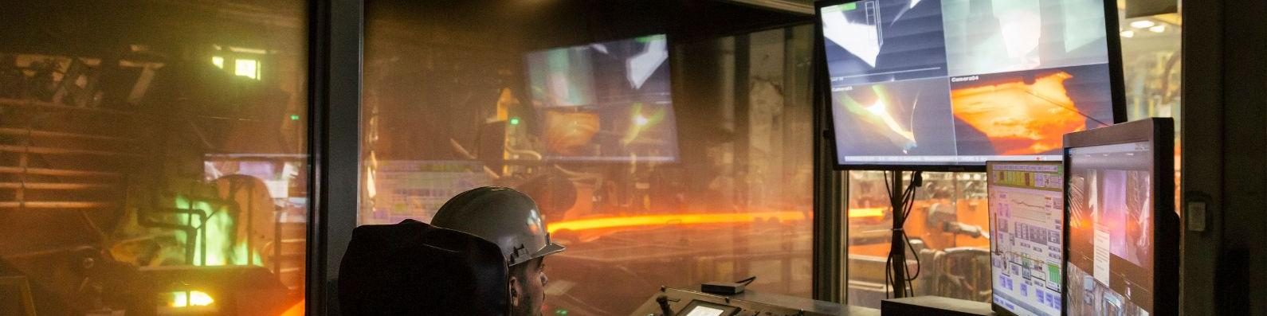
Lens: a strategic asset in Nexans’ copper value chain
Copper webinar
Context
Key figures
Industrial site active since the late 19th century; continuous copper casting introduced in 1971 and copper wire drawing activities since 2005
Nexans’ site in Lens (France) is the group’s main copper foundry, integrating both casting and wire drawing processes
A strategic asset to secure copper supply in a context of growing demand driven by electrification and the energy transition
700 t/day of copper produced through continuous casting
65,000 t/year copper drawing capacity (45 kt rod + 20 kt fine wire)
> €90M investment plan to expand capacity and recycling, with expected benefits including:
  240,000 t/year production capacity expected in 2027 after the investment
  30–50% recycled copper used in site production by 2027 after the upgrade
  40 t/h productivity expected for the line after the 2027 upgrade

Slide 4
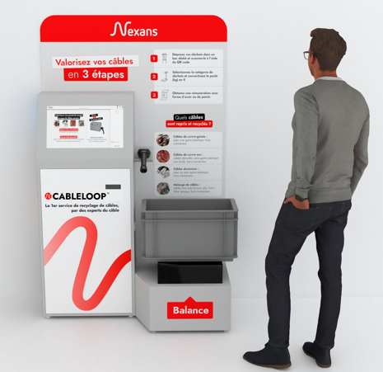

Cableloop: Recycling that counts
Copper webinar
Electricians:
Financial gain
Simplified waste management
Rewarding and recognized approach
Cableloop is a copper and aluminum recycling service with a dual target:
For enterprises: Collection of scrap from distributors' logistics centers and building sites, then transferred to recycling centers partnered with LTC by Nexans
Objectives
Nel 2025 67K tonnellate di rame è stato utilizzato in LTC grazie agli impianti di trafilatura di Veneta trafili
Distributors:
Branding: Innovation, Sustainable Customer Service
Consumer Flow
Loyalty
For professionals: Collection of scrap from distributor branches, supplied by electricians
17
11
5
LTC/Nexans:
Notoriety and brand image
Impact/expert innovation
Volume of waste vs. resource shortage
Strengthening partnerships with Platinum's
5
# Impianti
# Multifilo
# Intermedie
# Sbozzatori
Nexans’ commitment in cable recycling:
Gli impegni di LTC & Nexans nell’ambito del riciclo del Rame
60
30K
18K
13k
Years of expertise in recycling electrical cables
Aluminium and copper cables processed per year
of shot recovered per year
of polymers recycled per year

Slide 5
XAVIER’s Video
Key messages for Copper Trends
2 messages – Not more than 3 min

Slide 6
AURUBIS SLIDES HERE

Slide 7



Guidelines for a safe and transparent Q&A Session
Copper webinar
What can be said
What cannot be said
Talk about the copper market in general: global trends, demand and supply developments
Discuss public information or information in the public domain (e.g., data from federations, official reports)
Make macro-level considerations on factors influencing copper (e.g., international quotations, economic scenarios)
Share generic opinions that could be published in industry media
Prices: never go into detail, neither by customer nor by competitor
Information about distributors or suppliers: commercial policies, stock levels, product launches, promotions
Operational details: sales techniques, price lists, specific updates
Participation in initiatives of distributors or competitors: avoid confirmations or details

